Slide 1
Welcome

Slide 2
Linear Search

Slide 3
Bubble Sort

Slide 4
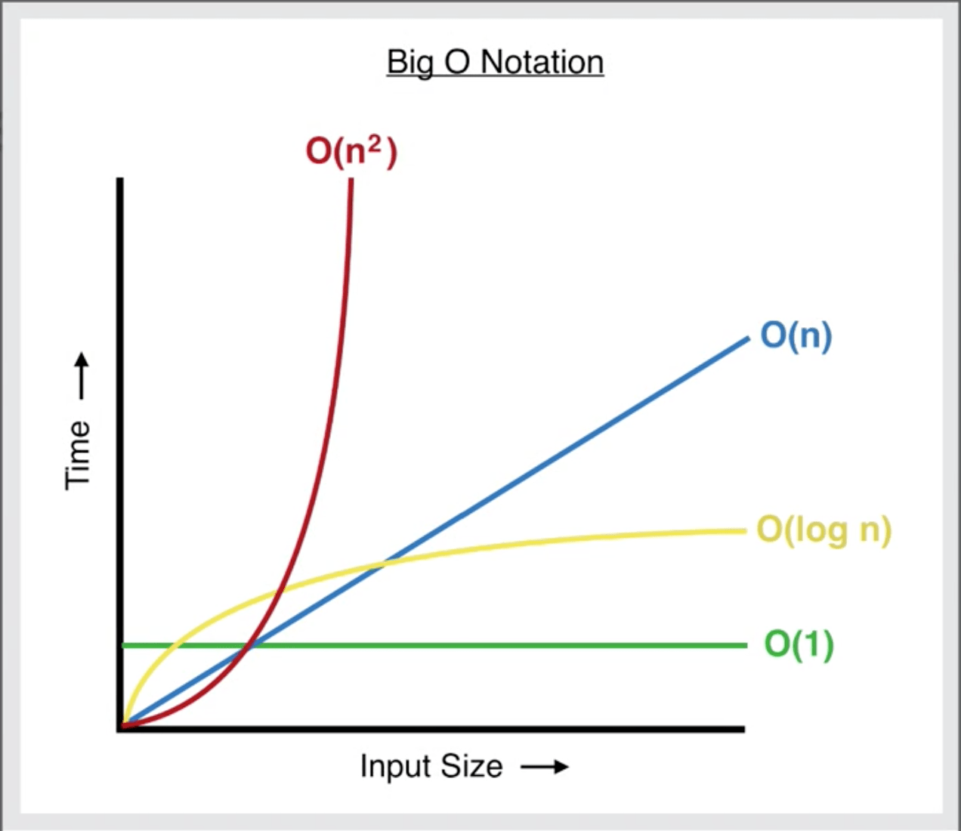
Big O Complexities

Slide 5
Priority Queues
Output:

Slide 6
My Basic Implementation

